Slide 1

LoponCRM

Slide 2
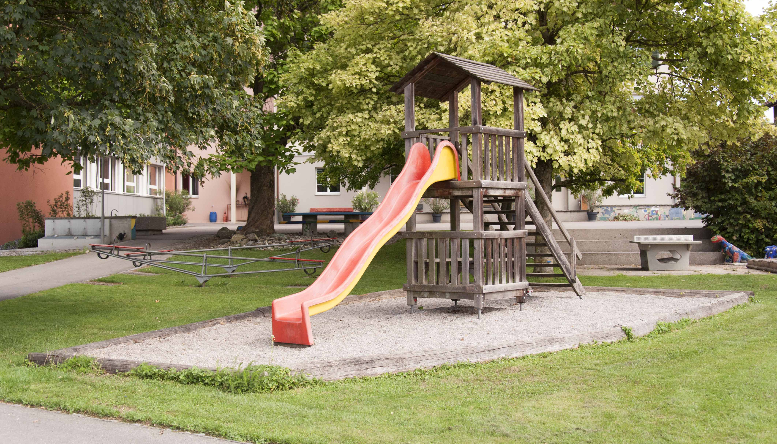

Slide 3

Money money money

Slide 4
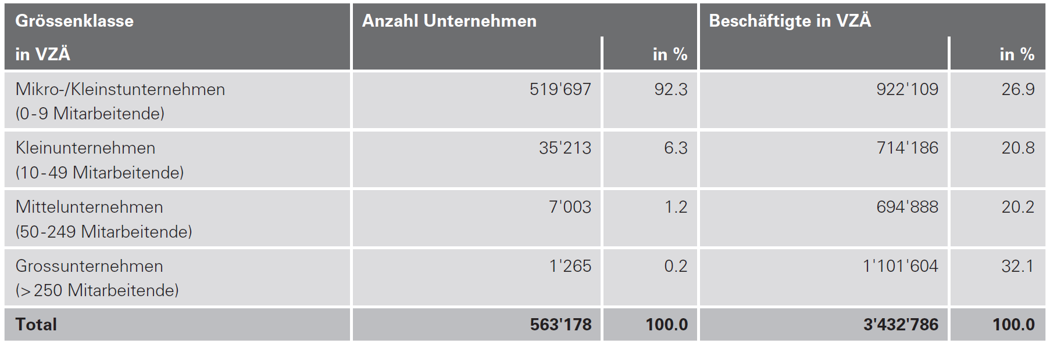
Zielgruppe

Slide 5


Slide 6

Vision

Slide 7

And the winner is…

Slide 8














Slide 9


Slide 10

?

